Slide 1
Safe internet
Grigiškių „Šviesos“ gimnazijos mokiniai
Dovydas Petrošius
Pijus Bieliauskas

Slide 2
Social networks

Slide 3
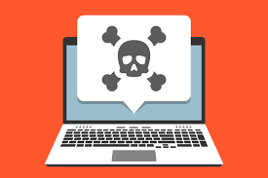
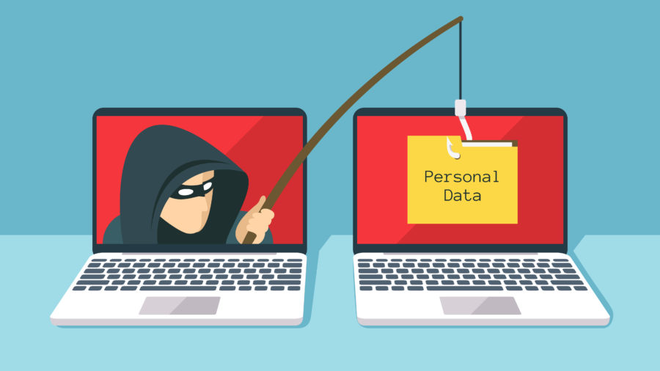
Risks of unprodected browsing

Slide 4
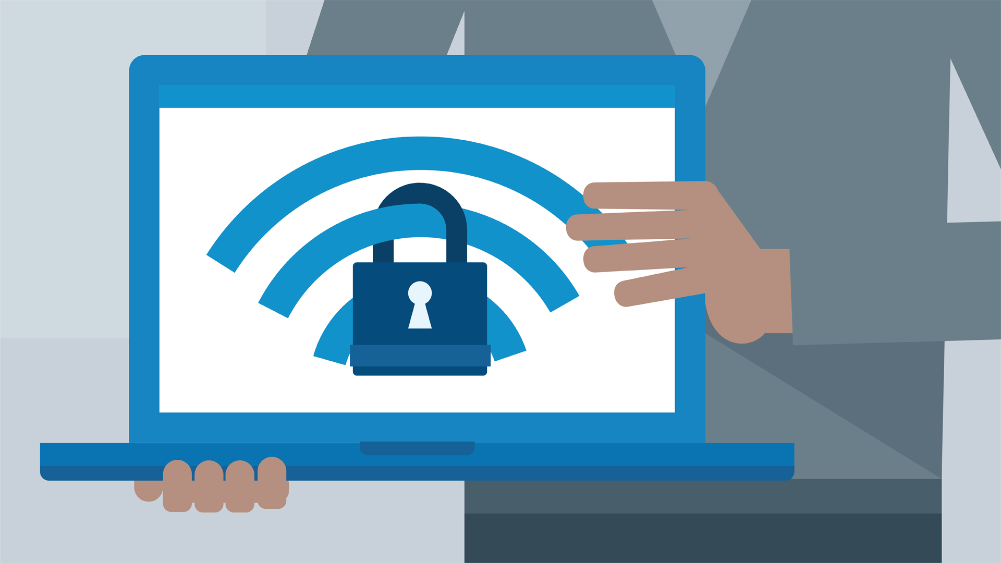
Tips on how to browse the internet safely
Post mindfully: this is how we represent ourselves online, and the information we place permanently stays on the web.
Power in passwords: always make sure passwords are unique and special; use specific guidelines when creating them.
Watch In-App purchases: be careful when upgrading a new game or app—it can add up to a lot of additional costs.
Be socially conscious: how we manage our social media profiles is very important.
Be careful what you download: a top goal of cybercriminals is to trick you into downloading malware—programs or apps that carry malware or try to steal information.
Keep your antivirus program up to date: internet security software cannot protect against every threat, but it will detect and remove most malware—though you should make sure it's to date.

Slide 5
Sources
https://www.wabisabilearning.com/
https://usa.kaspersky.com/

